Slide 1
Nurturing Communities in Higher Education: Helping At-Risk Undergraduate Students "Show Up and Do What Matters”
Panel Discussion
Association for Contextual Behavioral Sciences
World Conference 2016
Notes:
Jenn

Slide 2
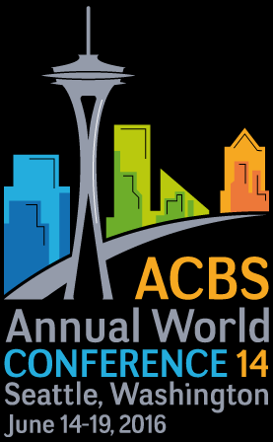
Need CE credit for this session?
Please don’t forget to scan in to have your attendance tracked.
Notes:
Don

Slide 3
Overview
Introductions
Background/context of work
Scope of work
Some nuts-and-bolts
Discussion questions
Discussion/audience Q&A

Slide 4
Introductions: What launches our ships?
Panelists
  Jennifer Block-Lerner, PhD (also co-chair)
  Donald R. Marks, PsyD (also co-chair)
  Jacqueline Pistorello, PhD
  Ashlyne Mullen, MS
Discussant
  Michael Femenella, PhD
Notes:
Jenn
How we came to do this work. How we want to approach this work

Slide 5
Disclosures
Jennifer Block-Lerner, PhD
  Receives royalties from Routledge/Taylor and Francis for a book co-edited on a topic similar to this presentation
  Faculty member at Kean University
  Employed in private practice
Donald R. Marks, PsyD
  Faculty member at Kean University
  Employed in private practice
Jacqueline Pistorello, PhD
  Receives royalties from New Harbinger Publications, Inc. for an edited book on a topic similar to this presentation
  Research funded by grants from the National Institute of Mental Health (R01 MH083740) and the National Center for Complementary & Integrative Health (R44AT006952)
Ashlyne Mullen, MS
  Has not received any commercial support related to this presentation or the work presented in this presentation
Michael Femenella, PhD
  Employed in private practice

Slide 6
College represents the only time in many people’s lives when a single setting encompasses their main activities, social networks, and a range of supportive services and organizations (Eisenberg et al., 2009, p. 1).
Notes:
Don

Slide 7
Challenges facing undergraduate students
Undergraduates face a host of psychological/behavioral difficulties, including high levels of anxiety and depression, substantial substance use, and academic challenges (see Block-Lerner and Cardaciotto [2016]; Pistorello et al. [2013] for reviews)
Economically at-risk and first generation students often face even greater challenges as they attempt to navigate their academic journeys:
  Holding relatively high levels of work and family responsibilities
  Living with consequences of poverty and chronic economic distress (including higher rates of childhood maltreatment, lack of support networks)
College student athletes also face additional unique challenges as they juggle many significant time commitments and face pressure and often narrow definitions of success
Notes:
Don

Slide 8
Relevance of the psychological flexibility model
The psychological flexibility model (e.g., Hayes et al., 2006) explicitly addresses the relevance of difficult experiences, including feelings of inadequacy and fears of failure, as normative aspects of the human learning process
In this context, students can explore willingness to feel afraid or inadequate in the service of their larger motivations for participating in the academic community and obtaining an academic degree
Notes:
Don

Slide 9
Cultivating nurturing communities
Many ways to build nurturing communities (Biglan, 2015), promoting collaboration and connectedness on and off campus (also see Cardaciotto et al., 2016; Pistorello, 2013)
  Create opportunities for collaboration between faculty and students (i.e., welcome students to academic community)
  Model committed action and engagement in “what matters” (i.e., what is education for?)
  Minimize coercive assignments and emphasize common experiences with difficult material or unfamiliar situations (i.e., “We’re all in the same soup.”)
  Develop course tasks promoting active participation in the local community or university (e.g., mentoring or coaching others; volunteering, hosting a public debate)
  Highlight opportunities for participation in the larger academic community (e.g., noting events on campus, planning special events or activities)
Notes:
Don

Slide 10
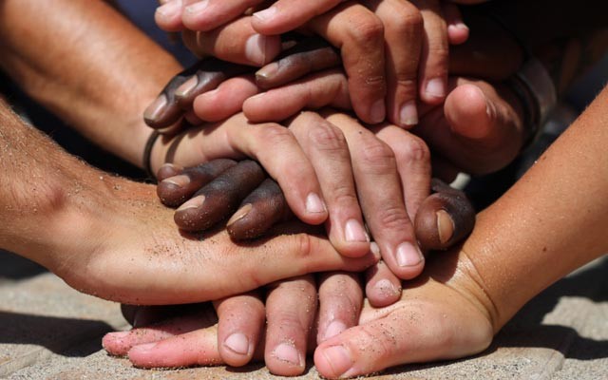
Some benefits of nurturing communities
Joy of discovery – shared exploration of life’s mysteries
Help when life hurts – forming connections with compassionate others (“buffering” the “slings and arrows”)
Membership in larger human community – access to the world’s wisdom traditions, a sense of place and belonging
Shared perspective – a sense of what matters in life and a reason to show up
Potential of nurturing communities
in higher education to effect
societal change (Cardaciotto et al.,2016)
Notes:
Don

Slide 11
Essence of Showing Up and Doing What Matters
Would you be willing to experience the fear and other emotions associated with this particular course, assignment, or social experience in the service of moving in the direction of the life you want to lead?
In what ways can I/we contribute to building and sustaining nurturing communities at the level of our home institutions and places of work and life?
Notes:
Jenn
Interventions to be discussed today center around or boils down to this kind of big question (first one)…
And encourages all of us to sit with this big question (second one)…

Slide 12
Scope of work at Kean
First year experience seminars
Undergraduate curriculum development
Faculty support and training
Work with student athletes
Extracurricular workshops (e.g., on procrastination)
Academic coaching with at-risk students
Individual psychotherapy with students
Curriculum-grounded workshops
Drop-in practice sessions
Advising/mentoring including through the graduate school application process
Notes:
Jenn
This is where we will each discuss our own (and shared) work for a few minutes each. We would basically each indicate the contexts in which we’ve worked with students and other populations within higher education without going into detail.

Slide 13
Showing Up and Doing What Matters
More a framework than a protocol per se, though do have several protocols we use in group settings
Components from typical workshops
  Large group workshops, typically with lower-level students
    Big Rocks story - to set the scene and emphasize values from the start
    Introduction to mindlessness/mindfulness
    Mindfulness practice – usually mindful eating (raisin or Hershey kisses)
    Bullseye or commencement celebration writing exercise
    “Hug” exercise – experiencing different ways of holding challenging emotional experiences (D. Tirch, personal communication, December 2010)
Notes:
Ash/Jenn
We are flexible about what we include here. Does anyone want to add anything or otherwise adjust this?

Slide 14
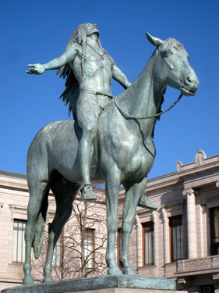
Showing Up and Doing What Matters (cont.)
  Smaller group workshops, often with upper-level students or those we anticipate will be more interactive
    What’s on your plate? exercise
      Responsibilities, tasks on our plates
      Emotions that come up as we consider them
      Ways we try to manage those emotions
    Defining “effectiveness” in light of values-
    consistent action
    Commencement celebration exercise
    “Hug” exercise
Notes:
Ash

Slide 15
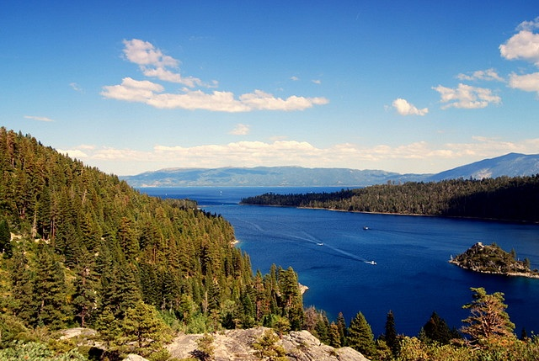


Nurturing Communities in Higher Education
Jacqueline Pistorello, Ph.D.
University of Nevada, Reno (UNR)
Counseling Services

Slide 16
Scope of work at UNR
Traditional Psychotherapy
Individual and group therapy
Classes
ACT First Year Experience as Universal Prevention
Web-based Treatment
Guided Self-Help at Counseling Centers
Outreach
Peer Mentoring Student Support Network (SSN)

Slide 17
More Distressed Students
Liked ACT Class Better
Student Evaluation of Educational Quality (SEEQ) total (up is good)
Psych Distress *cond: p = .01
General Health Questionnaire (GHQ) quartiles (up is bad)

Slide 18
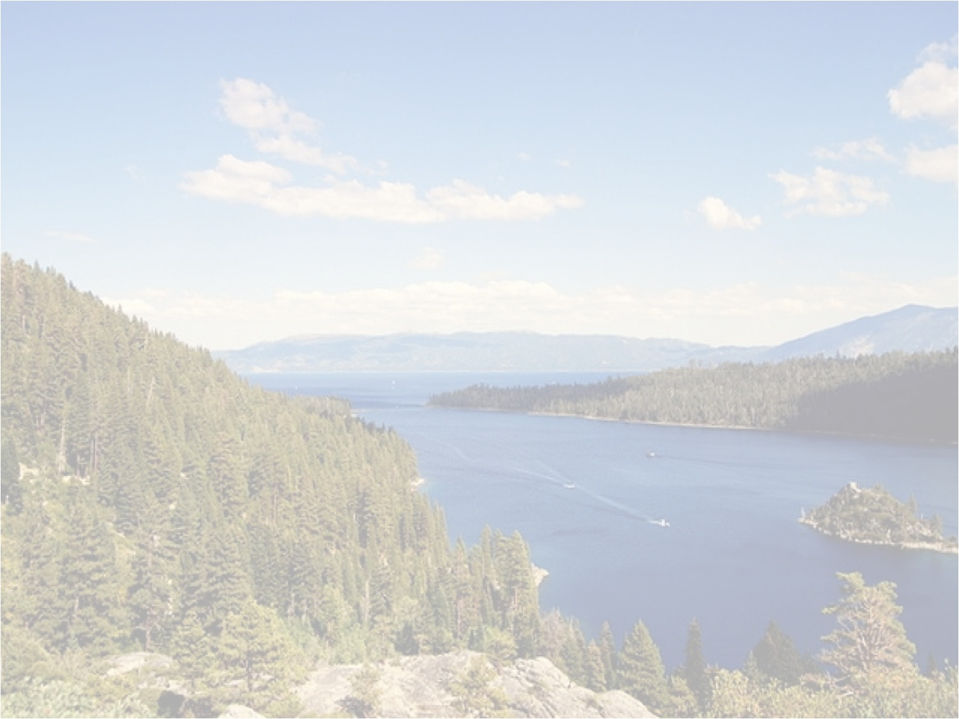
ACT on College Life:
A Guided Self-Help Program for College Counseling Centers
Michael Levin, Jacqueline Pistorello,
Steven C. Hayes, John Seeley, & Crissa Levin
This research was supported by a Phase I Small Business Innovation Research grant from the National Institute of Mental Health (NIMH; R43MH085336; Levin, Pistorello, Hayes, & Seeley) and one Phase II grant from the National Center for Complementary & Integrative Health (NCCIH; R44AT006952; Levin, Pistorello, Levin, Hayes, & Seeley) –all awarded to Contextual Change LLC

Slide 19
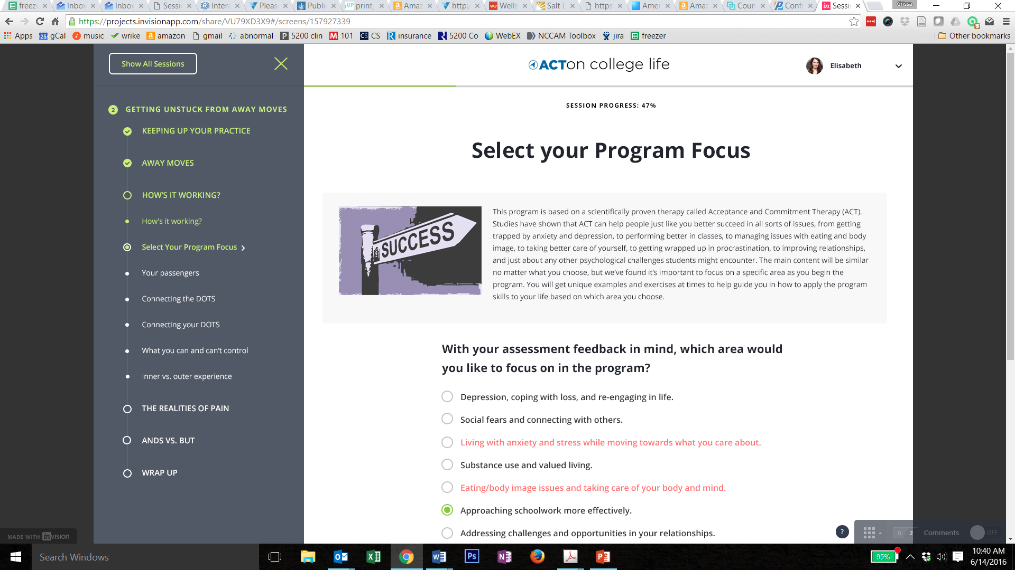

Slide 20
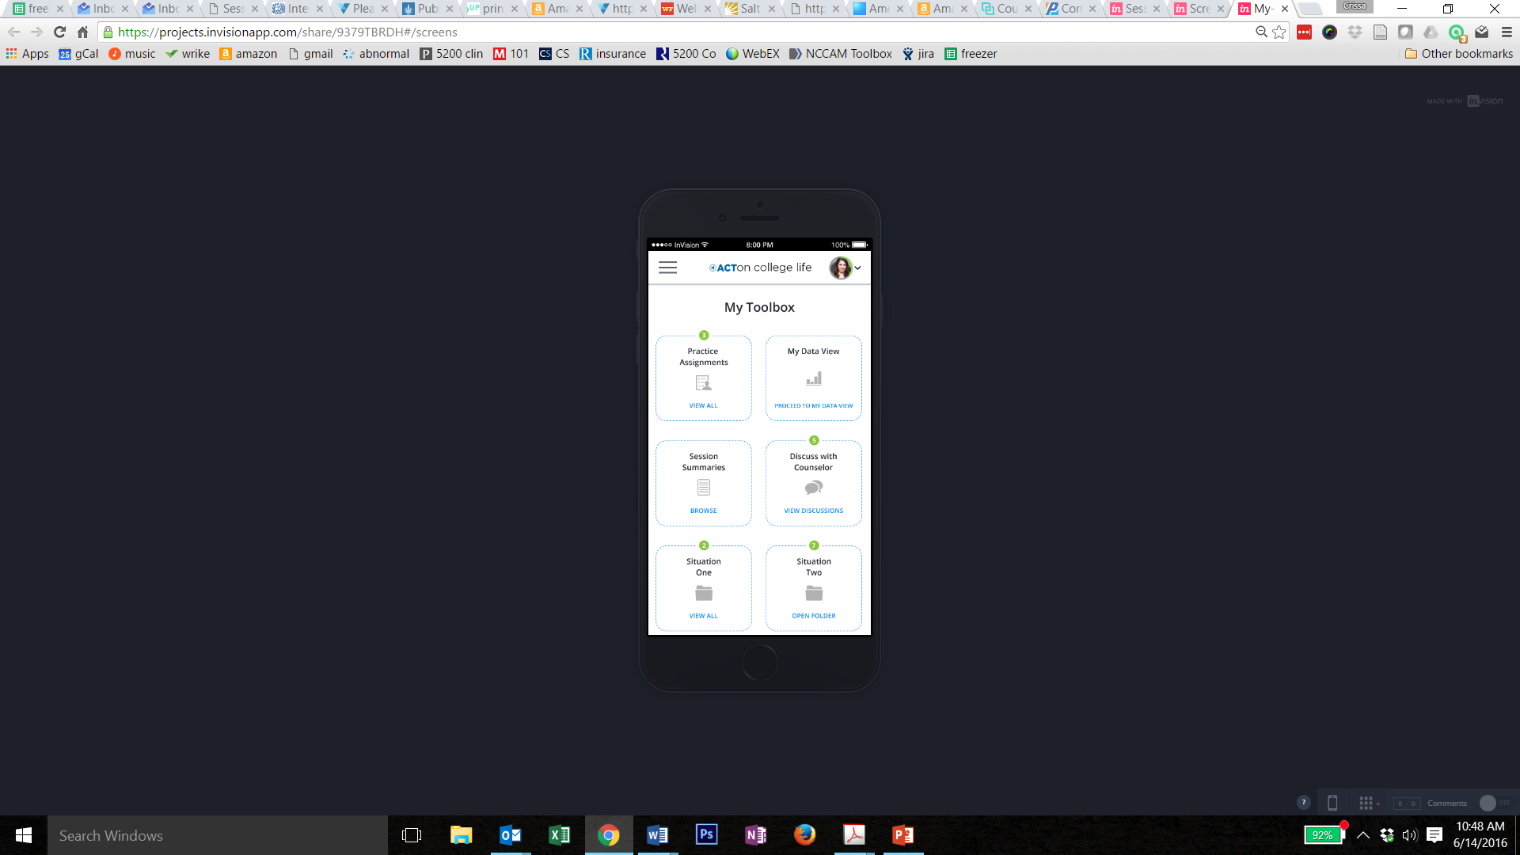

Slide 21
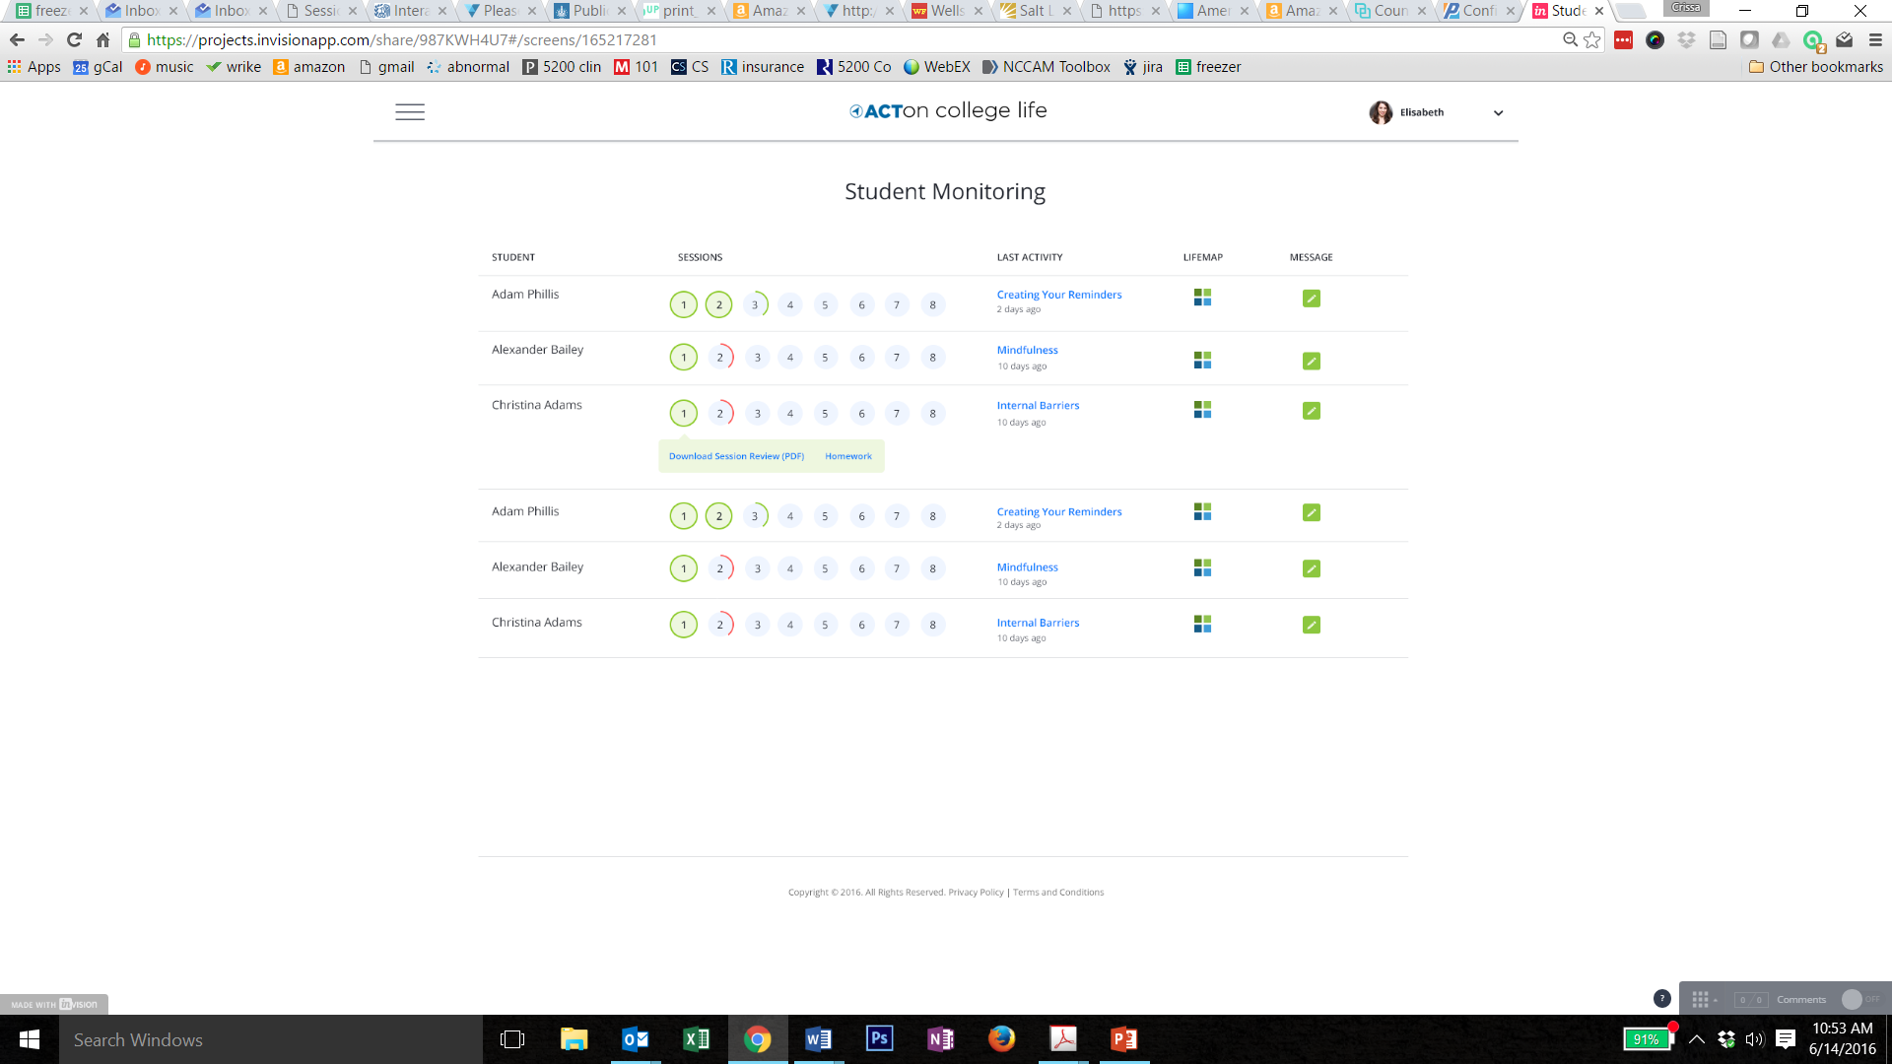

Slide 22
Student Support Network (SSN)
ACT-Based Peer Mentoring
  Charles Morse, Worcester Polytechnic Institute
  6 sessions, 1 hour each
  Student leaders nominated by faculty
  ACT Light: ubiquity of human suffering, modeling psychological flexibility, acceptance, valued-based actions, backpack metaphor, perspective taking
  Other: Rogerian stuff – listening & validation
Notes:
Reference: Morse, C. (2013). Teaching mindfulness and acceptance within college communities to enhance peer support. In J. Pistorello (Ed.), Mindfulness and acceptance for counseling college students: Theory and practical applications for intervention, prevention, and outreach. Oakland, CA: New Harbinger.
Evidence of direct impact on those serving as peer mentors
Impact on campus as a whole difficult to assess and little data from peer mentoring in general
Key Question: Can we create cultural change on campus?

Slide 23
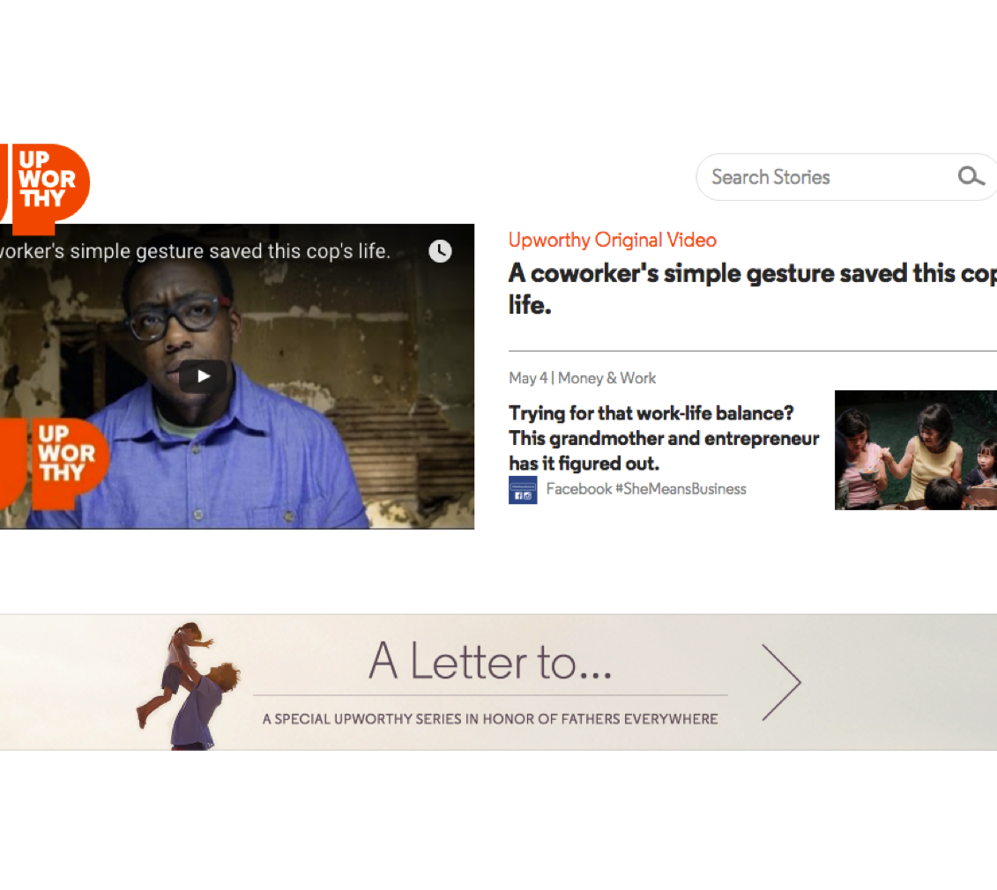
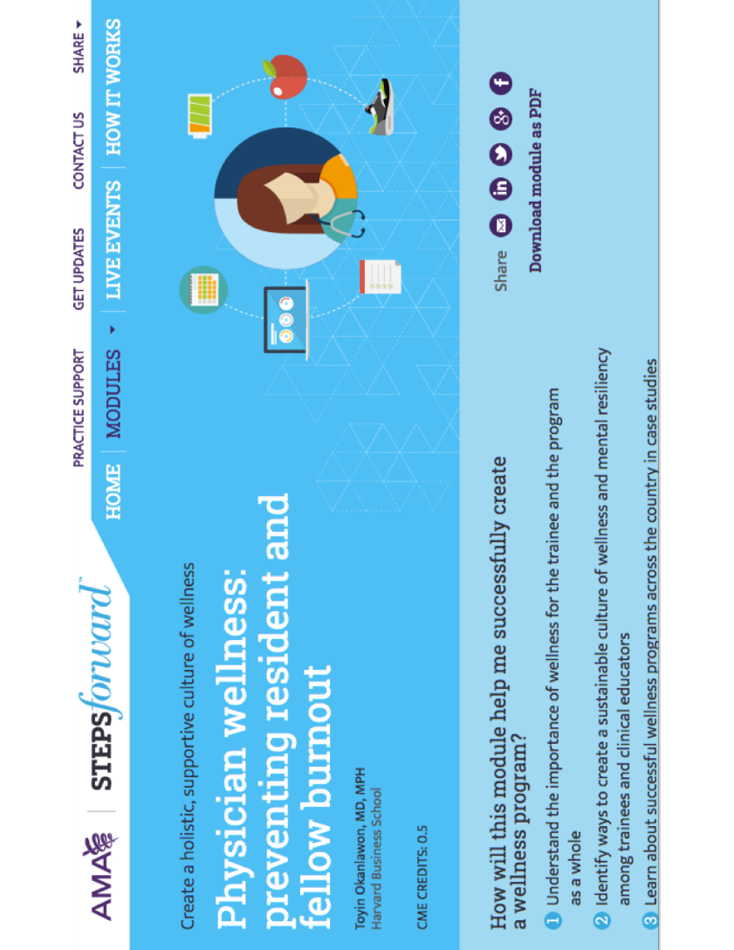
Other Examples
Notes:
Pistorello, J., Hayes, S. C., Lillis, J., Long, D., Christodoulou, V., LeJeune, J., et al., (2013). Acceptance and Commitment Therapy (ACT) in classroom settings. In J. Pistorello (Ed.), Mindfulness and acceptance for counseling college students: Theory and practical applications for intervention, prevention, and outreach. Oakland, CA: New Harbinger.

Slide 24
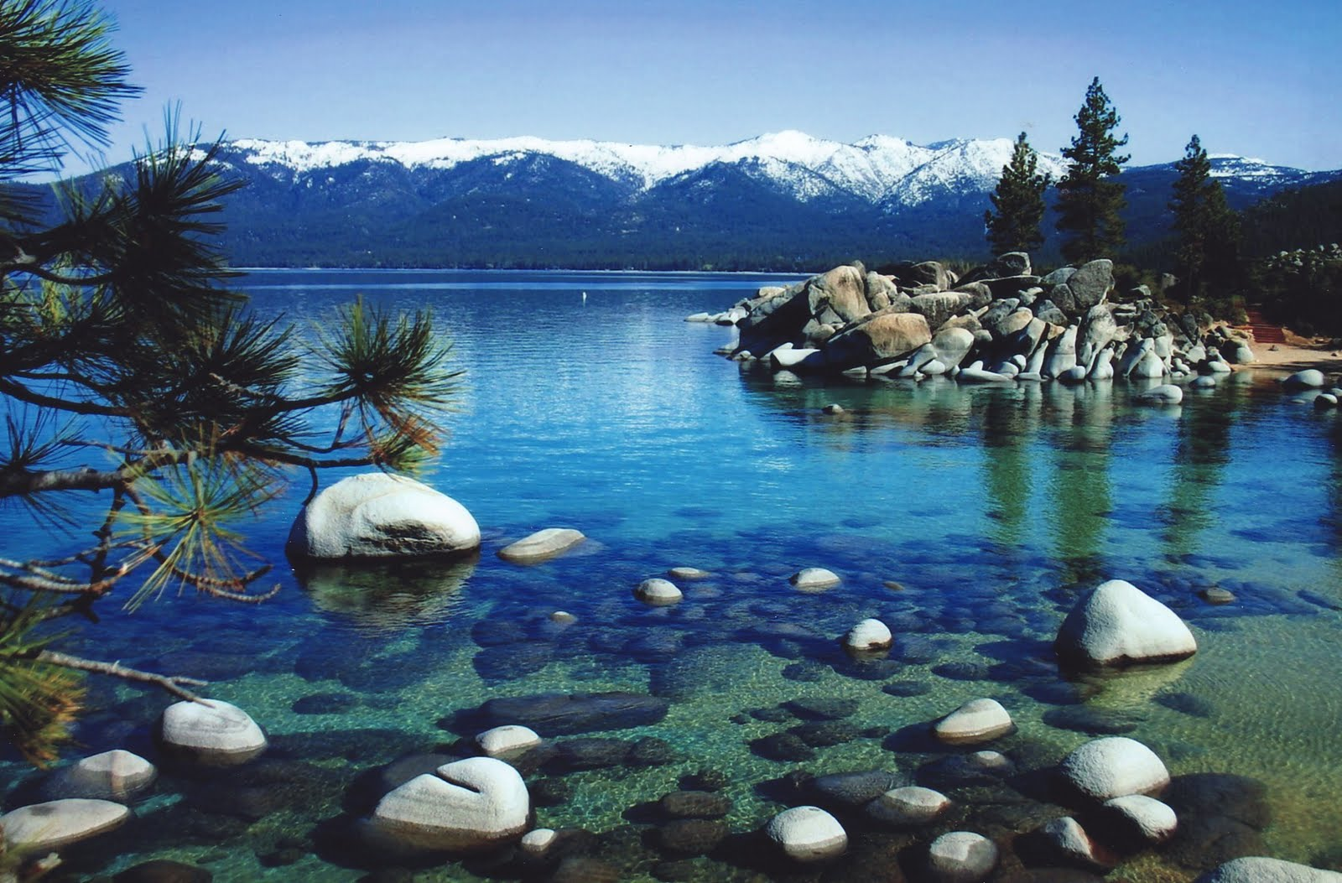
Nurturing Environment
University Administrators
Counseling Center Directors, Chairs, Deans
Therapists, Professors
Students

Slide 25
Discussion questions
What are some of the challenges in establishing a nurturing community in educational contexts?
How do you think the balance between universal prevention efforts and more targeted intervention work is best struck?
How do academic environments and the function and purpose of “a college education” differ across socioeconomic contexts?
What moments stand out as most memorable and how have these moments shaped your work or perspective on this work?

Slide 26
Discussion/Audience Questions
Notes:
Mike – up to you as to whether you talk for a bit and then open it up to audience questions or we ask for questions and then you wrap it up/discuss.

Slide 27
Contact information
Jennifer Block-Lerner – jlerner@kean.edu
Donald Marks – domarks@kean.edu
Jacqueline Pistorello - jacqueline.pistorello@gmail.com
Ashlyne Mullen – mullenre@kean.edu
Michael Femenella – mfemenella@yahoo.com
Notes:
Also add conclusions

Slide 28
References
Biglan, A. (2015). The nurture effect: How the science of human behavior can improve our lives and our world. Oakland, CA: New Harbinger.
Block-Lerner, J., & Cardaciotto, L. (Eds.; 2016). The mindfulness-informed educator: Building acceptance and psychological flexibility in higher education. New York: Routledge/Taylor & Francis Group.
Cardaciotto, L., Hill, L. G., Biglan, A., & Block-Lerner, J. (2016). Applying prevention science to influence a cultural revolution in higher education. In Block-Lerner, J. & Cardaciotto, L. The mindfulness-informed educator: Building acceptance and psychological flexibility in higher education. New York: Routledge/Taylor & Francis Group.
Eisenberg, D., Downs, M. F., Golberstein, E., & Zivin, K. (2009). Stigma and help seeking for mental health among college students. Medical Care Research and Review, 66, 522-541. doi: 10.1177/1077558709335173
Hayes, S. C., Luoma, J. B., Bond, F. W., Masuda, A., & Lillis, J. (2006). Acceptance and commitment therapy: Model, processes and outcomes. Behaviour Research and Therapy, 44, 1-25. doi:10.1016/j.brat.2005.06.006
Pistorello J. (Ed.). (2013). Mindfulness and acceptance for counseling college students: Theory and practical applications for intervention, prevention, and outreach. Oakland, CA: New Harbinger.

Slide 29
Wrapping up
Please don’t forget to scan out if you need CE credit.
What did you think?....
Complete the 3 question quickeval
for this session at
https://contextualscience.org/quickeval
This presentation was session #91

